Slide 1

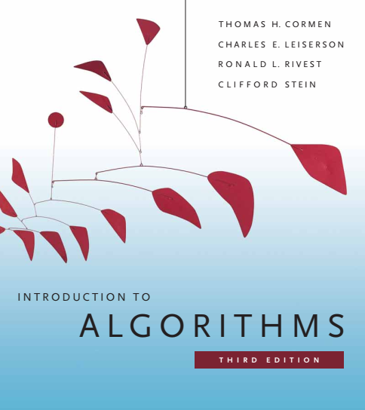
Design and Analysis of Algorithms
Dr. Sajid Iqbal
sajidiqbal.pk@gmail.com
Reference Book
Introduction to Algorithms 3rd Edition By Thomas H. Cormen et. al.
https://mitpress.mit.edu/books/introduction-algorithms-third-edition
COMEDXD

Slide 2
Binary Search Trees
Insertion and deletion

Slide 3
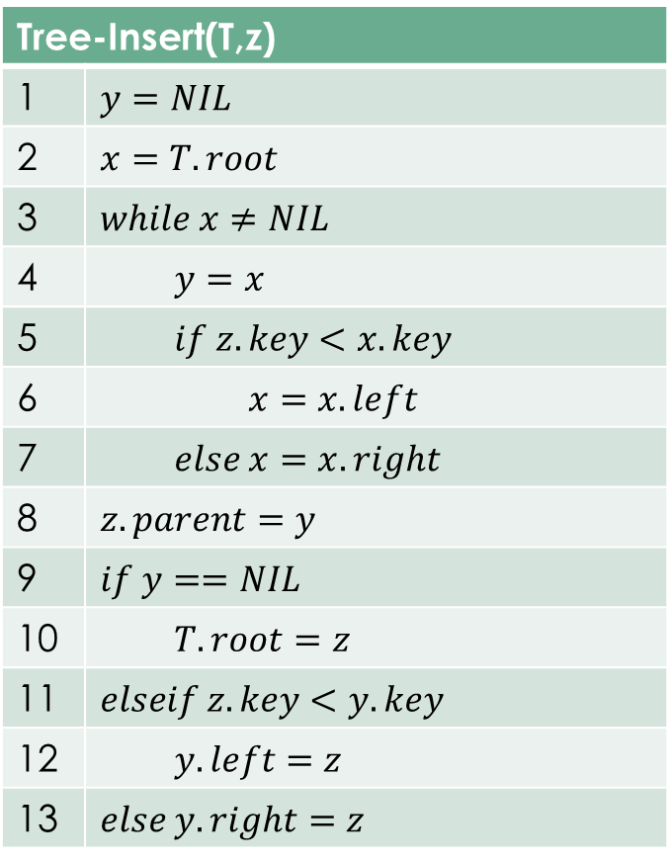
Insertion in BST
Tree-Insert(T,z)
1 | $$y=NIL$$
2 | $$x=T.root$$
3 | $$while x≠NIL$$
4 | $$y=x$$
5 | $$if z.key<x.key$$
6 | $$x=x.left$$
7 | $$else x=x.right$$
8 | $$z.parent=y$$
9 | $$if y==NIL$$
10 | $$T.root=z$$
11 | $$elseif z.key<y.key$$
12 | $$y.left=z$$
13 | $$else y.right=z$$
12
5
18
2
9
15
19
13
17

Slide 4
Deletion from BST
Let z is the node to be deleted from BST. This deletion has three basic cases
If z has no children, then simply remove it and place null pointer in its parent node for z
If z has just one child, then elevate that child to take z’s position in the tree by modifying z’s parent to replace z by z’s child.
If z has two children, then find z’s successor y—which must be in z’s right subtree—and have y take z’s position in the tree.
The rest of z’s original right subtree becomes y’s new right subtree, and z’s left subtree becomes y’s new left subtree.
This case is the tricky one because it matters whether y is z’s right child

Slide 5
The procedures to delete from BST
Z with no child: then we replace z by its right child, which may or may not be NIL.
When z’s right child is NIL, this case deals with the situation in which z has no children.
When z’s right child is non-NIL, this case handles the situation in which z has just one child, which is its right child
Z with one child on left: replace z by its left child
Z with both children: find z’s successor y, which lies in ´’s right subtree and has no left child
splice y out of its current location and have it replace z in the tree
If y is z’s right child, then replace z by y, leaving y’s right child alone
Otherwise, y lies within z’s right subtree but is not z’s right child. In this case, first replace y by its own right child, and then we replace z by y

Slide 6






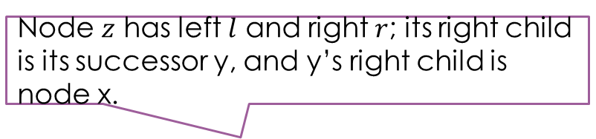

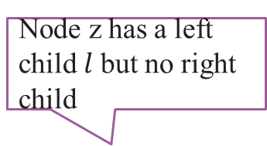
Z has no left child
Node z has a left child $l$ but no right child
Node $z$ has left $l$ and right $r$; its right child is its successor y, and y’s right child is node x.
q
q
q
z
z
z
r
$$l$$
$$l$$
$$y$$
$$x$$
q
q
q
y
r
$$l$$
$$l$$
$$x$$
replace z by y, updating y’s left child to become l, but leaving x as y’s right child

Slide 7
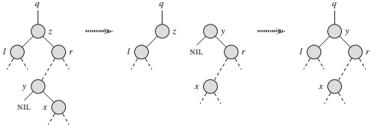

Deleting a node from BST
Node $z$ has two children ($l,r$): its successor $y≠r$ lies within the subtree rooted at $r$.
Replace $y$ by its own right child $x$, and set $y$ to be $r’$s parent. Then, set $y$ to be $q$’s child and the parent of $l$.

Slide 8
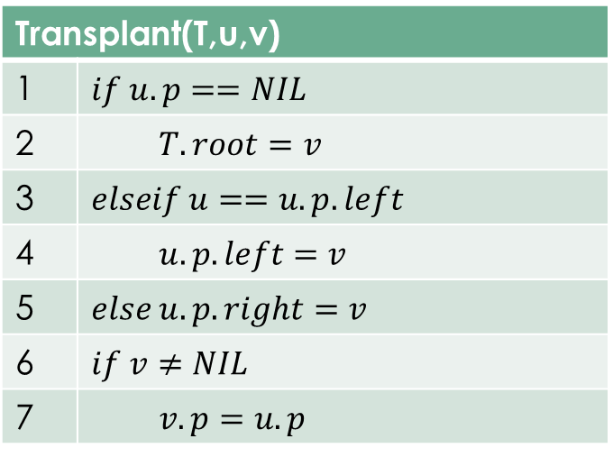


Transplant
Transplant is a procedure to move subtrees around within BST
It replaces one subtree as a child of its parent with another subtree
When TRANSPLANT replaces the subtree rooted at node $u$ with the subtree rooted at node $v$, node $u$’s parent becomes node $v$’s parent, and $u$’s parent ends up having $v$ as its appropriate child
Lines 1–2 handle the case in which u is the root of T
Otherwise, u is either a left child or a right child of its parent. Lines 3–4 take care of updating $u.p.left$ if u is a left child, and line 5 updates $u.p.right$if u is a right child
lines 6–7 update v:p if v is non-NIL
Transplant(T,u,v)
1 | $$if u.p==NIL$$
2 | $$T.root=v$$
3 | $$elseif u==u.p.left$$
4 | $$u.p.left=v$$
5 | $$else u.p.right=v$$
6 | $$if v≠NIL$$
7 | $$v.p=u.p$$

Slide 9
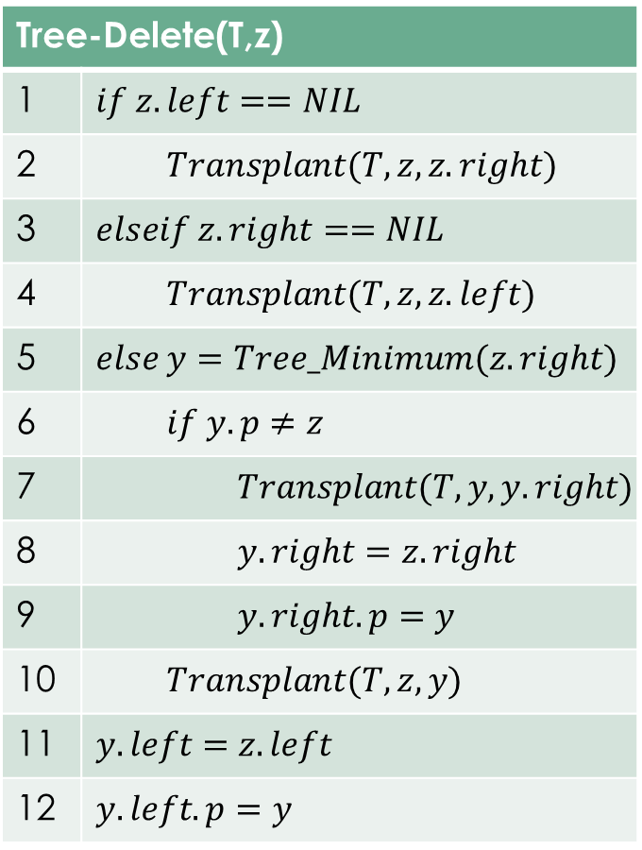
The TREE-DELETE procedure executes the four cases as follows.
Lines 1–2 handle the case in which node z has no left child
Lines 3–4 handle the case in which z has a left child but no right child.
Lines 5–12 deal with the remaining two cases, in which z has two children.
Line 5 finds node y, which is the successor of z.
Because z has a nonempty right subtree, its successor must be the node in that subtree with the smallest key
Splice y out of its current location, and it should replace z in the tree.
If y is z’s right child, then lines 10–12 replace z as a child of its parent by y and replace y’s left child by z’s left child.
If y is not z’s left child, lines 7–9 replace y as a child of its parent by y’s right child and turn z’s right child into y’s right child,
Lines 10–12 replace z as a child of its parent by y and replace y’s left child by z’s left child
Tree-Delete(T,z)
1 | $$if z.left==NIL$$
2 | $$Transplant(T,z,z.right)$$
3 | $$elseif z.right==NIL$$
4 | $$Transplant(T,z,z.left)$$
5 | $$else y=Tree_Minimum(z.right)$$
6 | $$if y.p≠z$$
7 | $$Transplant(T,y,y.right)$$
8 | $$y.right=z.right$$
9 | $$y.right.p=y$$
10 | $$Transplant(T,z,y)$$
11 | $$y.left=z.left$$
12 | $$y.left.p=y$$
Each line of TREE-DELETE, including the calls to TRANSPLANT, takes constant time, except for the call to TREE-MINIMUM in line 5. Thus, TREE-DELETE runs in O(h) time on a tree of height h.

Slide 10



Thanks for watching
Dr. Sajid Iqbal
Assistant Professor
Department of Computer Science
Bahauddin Zakariya University, Multan
sajidiqbal.pk@gmail.com
https://github.com/sajjo79/Design_and_Analysis_of_Algorithms
COMEDXD
Allah Hafiz

